Slide 1
Introduction to Database Systems

Slide 2
Course Overview
Several main topics
  Database systems
  Data models
  Database design
  SQL
  Transactions
  Concurrency
  Administration

Slide 3
Why Study Databases?
Databases are useful
  Many computing applications deal with large amounts of information
  Database systems give a set of tools for storing, searching and managing this information
Databases in CS
  Databases are a ‘core topic’ in computer science
  Basic concepts and skills with database systems are part of the skill set you will be assumed to have as a CS graduate

Slide 4
What is a Database?
“A set of information held in a computer”
      Oxford English Dictionary
“One or more large structured sets of persistent data, usually associated with software to update and query the data”
      Free On-Line Dictionary of Computing
“A collection of data arranged for ease and speed of search and retrieval”
      Dictionary.com

Slide 5
Databases
Web indexes
Library catalogues
Medical records
Bank accounts
Stock control
Personnel systems
Product catalogues
Telephone directories
Train timetables
Airline bookings
Credit card details
Student records
Customer histories
Stock market prices
Discussion boards
and so on…

Slide 6
Database Users
End users
  Use the database system to achieve some goal
Application developers
  Write software to allow end users to interface with the database system
Database Administrator (DBA)
  Designs & manages the database system
Database systems programmer
  Writes the database software itself

Slide 7
Database Management Systems
A database is a collection of information
A database management system (DBMS) is the software than controls that information
Examples:
  Oracle
  DB2 (IBM)
  MS SQL Server
  MS Access
  Ingres
  PostgreSQL
  MySQL

Slide 8
What the DBMS does
Provides users with
  Data definition language (DDL)
  Data manipulation language (DML)
  Data control language (DCL)
Often these are all the same language
DBMS provides
  Persistence
  Concurrency
  Integrity
  Security
  Data independence
Data Dictionary
  Describes the database itself

Slide 9
File Based Systems
File based systems
  Data is stored in files
  Each file has a specific format
  Programs that use these files depend on knowledge about that format
Problems:
  No standards
  Data duplication
  Data dependence
  No way to generate ad hoc queries
  No provision for security, recovery, concurrency, etc.

Slide 10
Relational Systems
Problems with early databases
  Navigating the records requires complex programs
  There is minimal data independence
  No theoretical foundations
Then, in 1970, E. F. Codd wrote “A Relational Model of Data for Large Shared Databanks” and introduced the relational model

Slide 11
Relational Systems
Information is stored as tuples or records in relations or tables
There is a sound mathematical theory of relations
Most modern DBMS are based on the relational model
The relational model covers 3 areas:
  Data structure
  Data integrity
  Data manipulation
More details in the next lecture…

Slide 12
Table
“A table is the primary unit of physical storage for data in a database.”¹
Usually a database contains more than one table.

Slide 13
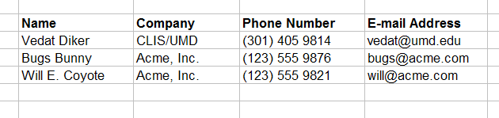
Table

Slide 14
A Database with Multiple Tables
[1]
Publishers
Books
Customers
Authors
Inventory
Orders
1) Stephens, R.K. and Plew. R.R., 2001. Database Design. SAMS, Indianapolis , IN. (with slight changes by V.G.D.)

Slide 15
Table
Customers

Slide 16
Field (Column)
Customers
a field

Slide 17
Record (Row)
Customers
a record

Slide 18
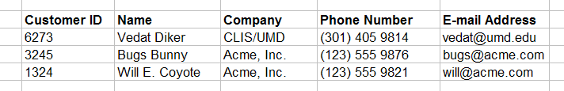
Primary Key
Customers
primary key field
Primary key is a unique identifier of records in a table.
Primary key values may be generated manually or automatically.

Slide 19
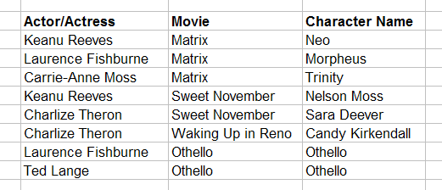
Primary Key
Roles (Performances)
primary key fields
A primary key can consist of more than one field.

Slide 20
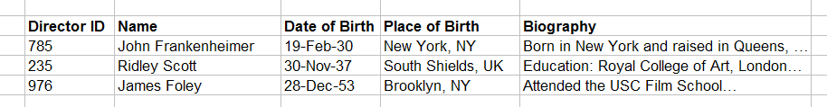
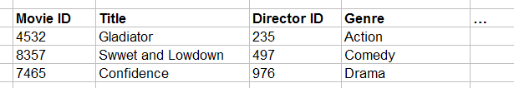
Foreign Key
primary key field
parent table
Directors
relationship
child table
Movies
foreign key field

Slide 21
Relationship Types
One-to-one
One-to-many
Many-to-many

Slide 22
Data Types
Alphanumeric (Text, Memo)
Numeric (Number, Currency, etc.)
Date/Time
Boolean (Yes/No)

Slide 23
Entity
“An entity is a business object that represents a group, or category of data.”¹
Do we know a similar concept?
1) Stephens, R.K. and Plew. R.R., 2001. Database Design, pp. 21. SAMS, Indianapolis , IN.

Slide 24
Attribute
“An attribute is a sub-group of information within an entity.”¹
Do we know a similar concept?
1) Stephens, R.K. and Plew. R.R., 2001. Database Design, pp. 21. SAMS, Indianapolis , IN.

Slide 25
Relationship
A relationship is a link that relates two entities that share one or more attributes.
Do we know a similar concept?

Slide 26
OO Design → DB Design
Class → Entity (Table)
Object → Record
Attribute → Attribute (Field)
Association → Relationship
…

Slide 27
Database Environments
Mainframe
Client/Server
Internet-based

Slide 28
Database Types
Flat-file
Hierarchical
Network
Relational
Object-oriented
Object-relational

